Slide 1

Customer Data Analysis
TEAM ID : PTID-CDA-JAN-26-1134
PROJECT ID : PRDA-05
NAME : Srashti Dubey
EMAIL: srashtidubey73@gmail.com
CAPSTONE PROJECT

Slide 2
Customer Data Analysis
This project analyzes customer transaction data to understand sales performance, customer behavior, and payment preferences. Using SQL, Excel, and Power BI, raw data was cleaned, validated, and transformed into an interactive business dashboard.
The dashboard provides insights into gender, age groups, product categories, payment methods, shopping malls, and revenue trends, helping identify top-performing segments and key business drivers.
Project Overview

Slide 3




KEY FOCUS
Gender-Based Analysis.
01uuujjkku000jjjj
Age Group Performance
Category-Wise Performance
Payment Method Analysis
Time-Based Trend Analysis

Slide 4



Customer Data Analysis
1.SQL: Data extraction, aggregations, analytical queries
2.Excel/CSV: Data cleaning , Exporting data from SQL
3. Power Query: Data cleaning & transformation
4. DAX: Measures for dynamic analysis
5.Power Bl: Interactive Dashboard design, visuals, KPI tracking
Tools & Technologies Used

Slide 5
Customer Data Analysis
Data Preparation Workflow
DATA CONNECTION
SQL DATA EXPLORATION
SQL ANALYSIS
(10 TASK)
DASHBOARD &
INSIGHT
LOAD INTO
POWER BI
EXPORT TO
EXCEL/CSV

Slide 6
Customer Data Analysis
1.How is the shopping distribution according to gender?
2. Which gender did we sell more products to?
3.Which gender generated more revenue?
4. Distribution of purchase categories relative to other columns?
5. How is the shopping distribution according to age?
6. Which age cat did we sell more products to?
7. Which age cat generated more revenue?
8. Distribution of purchase categories relative to other columns?
9. Does the payment method have a relation with other columns?
10. How is the distribution of the payment method?
Business Problem

Slide 7
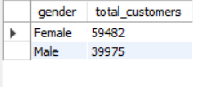
Customer Data Analysis
1.How is the shopping distribution according to gender?
Female customers contribute the highest share of customers

Slide 8
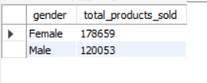
Customer Data Analysis
2.Which gender did we sell more products to?
Higher product quantity is driven by female

Slide 9
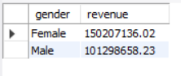
Customer Data Analysis
3.Which gender generated more revenue?
Revenue contribution is higher for female gender revealing a more valuable customer
segment

Slide 10
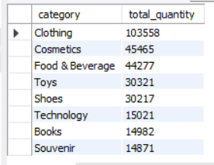
Customer Data Analysis
4.Distribution of purchase categories relative to other columns?
Clothing and
Cosmetics are
the top-performing
categories
across all age
groups ,
payment
Methods and gender.

Slide 11
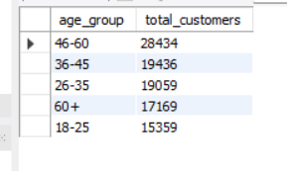
Customer Data Analysis
5.How is the shopping distribution according to age?
46–60 age group
has the highest number of
customers,
indicating
maximum
shopping
participation.

Slide 12
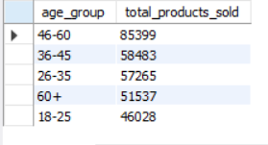
Customer Data Analysis
6.Which age cat did we sell more products to?
One age group category purchases the most items, highlighting strong buying intensity.

Slide 13
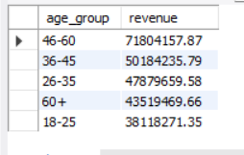
Customer Data Analysis
7.Which age cat generated more revenue?
Revenue contribution is highest from the 46–60 age group, making them the most profitable segment.

Slide 14
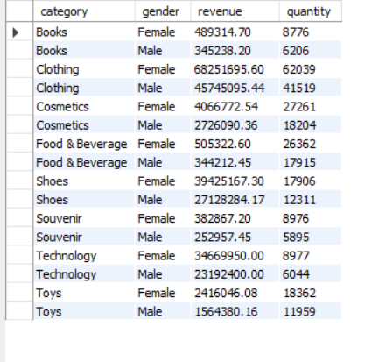
Customer Data Analysis
8.Distribution of purchase categories relative to other columns?
The 46-60 age group is
the most
profitable,
generating the
highest revenue
and quantity
sold, especially
in Clothing and
Cosmetics.

Slide 15
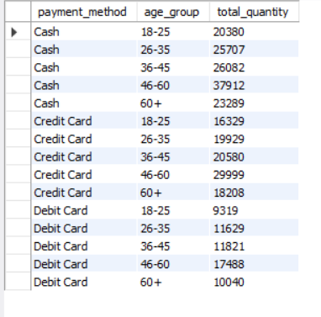
Customer Data Analysis
9.Does the payment method have a relation with other columns?
Female
customers lead
transactions
across all
payment
methods,
especially in
Cash and Credit
Cards, while
the 46–60 age group
contributes the
highest volume
and revenue
through Cash,
highlighting a
strong age-based payment
preference.

Slide 16
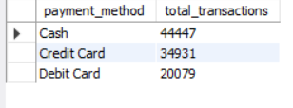
Customer Data Analysis
10.How is the distribution of the payment method
Cash is the
dominant
payment
method, ~44%
of total revenue, making it the
most
preferred
payment mode.

Slide 17

Customer Data Analysis
Female customers are
the most valuable
segment, contributing
the highest customer
count, product volume, and total revenue.
The 46–60 age group is the most
profitable, generating the
highest revenue and
quantity sold, especially
in Clothing and Cosmetics.
Cash & Cards are the most preferred modes
Mall of Istanbul is the highest
revenue-generating mall.
2022 was the strongest
sales year, while 2023 shows
a decline, indicating a need for
growth-focused strategies.

Slide 18
Customer Data Analysis
s
Some malls generate significantly lower revenue compared to top malls like Mall of Istanbul. Introduce local promotions, mall-specific discounts, and in-store events in low-performing malls to increase footfall and sales.
Target Female customers and the 46–60 age group Develop targeted loyalty programs, personalized offers, and premium membership plans for this segment to improve retention and increase lifetime customer value.
Business Recommendations
Allocate more marketing budget, shelf space, and stock to these categories and introduce bundle offers (e.g., Clothing + Cosmetics) to boost cross-selling.
Keep cash offers active, but also promote credit card cashback & EMI schemes to encourage higher-value purchases.

Slide 19
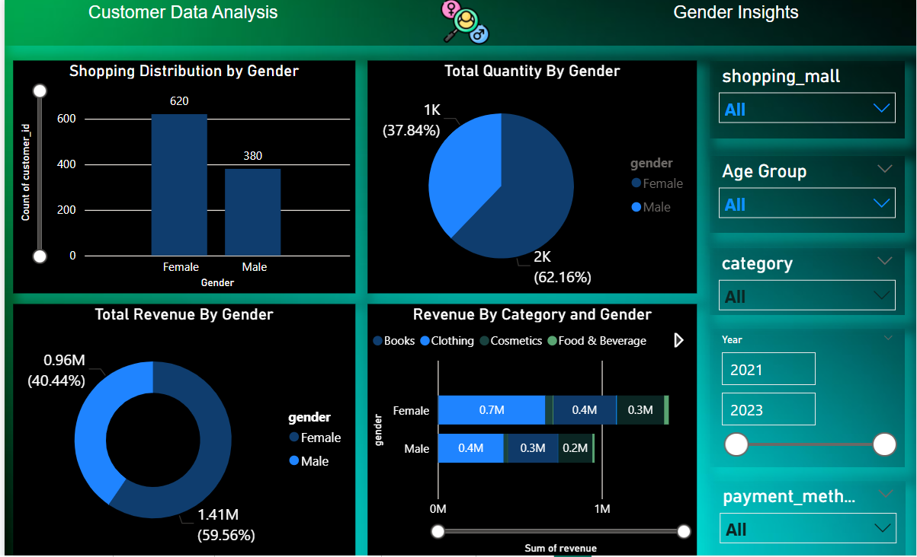
Customer Data Analysis

Slide 20
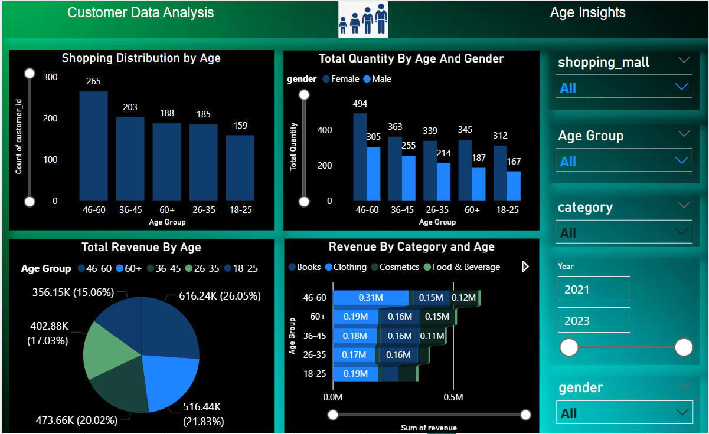
Customer Data Analysis

Slide 21
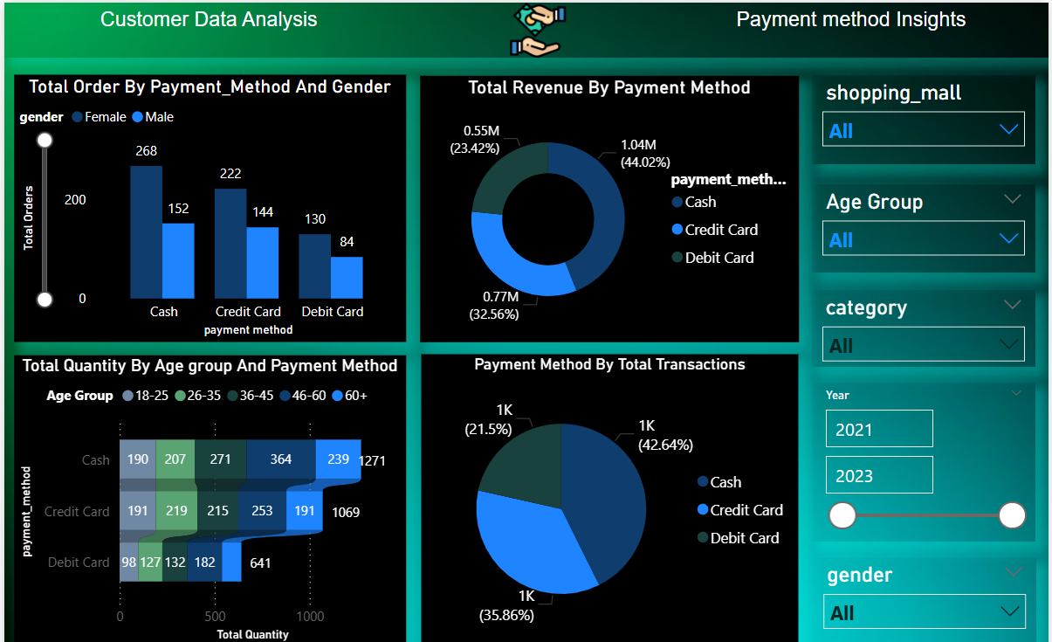
Customer Data Analysis

Slide 22
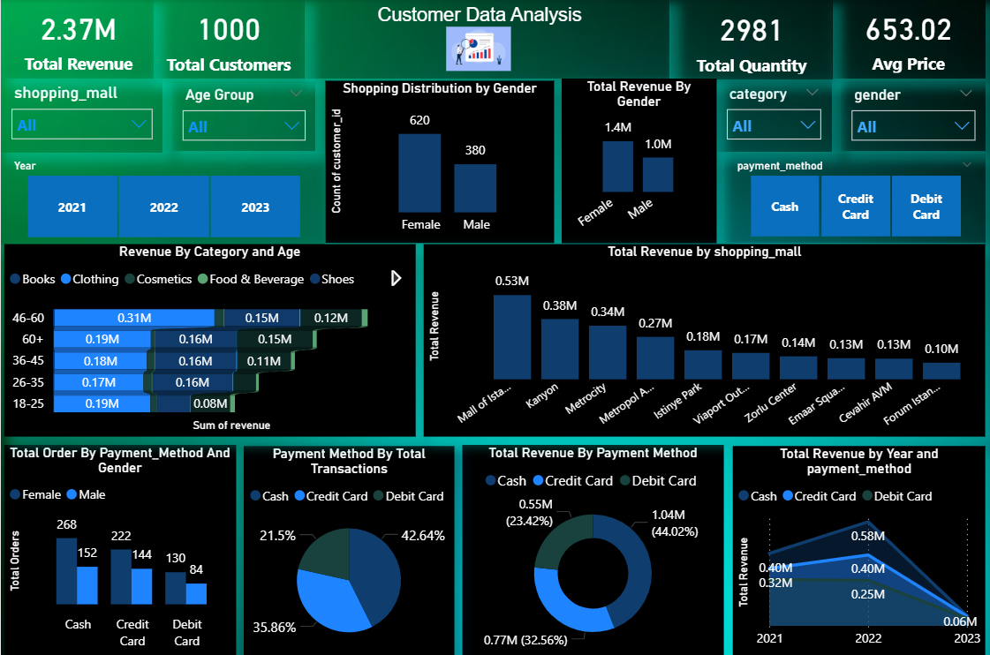
Customer Data Analysis

Slide 23
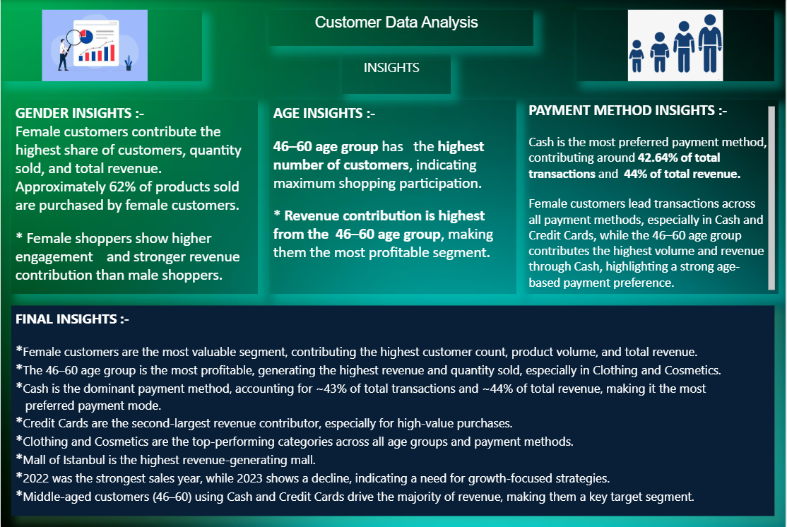
Customer Data Analysis

Slide 24


